Slide 1
Cardio Shield AI
Revolutionizing Heart Health Prevention

Slide 2
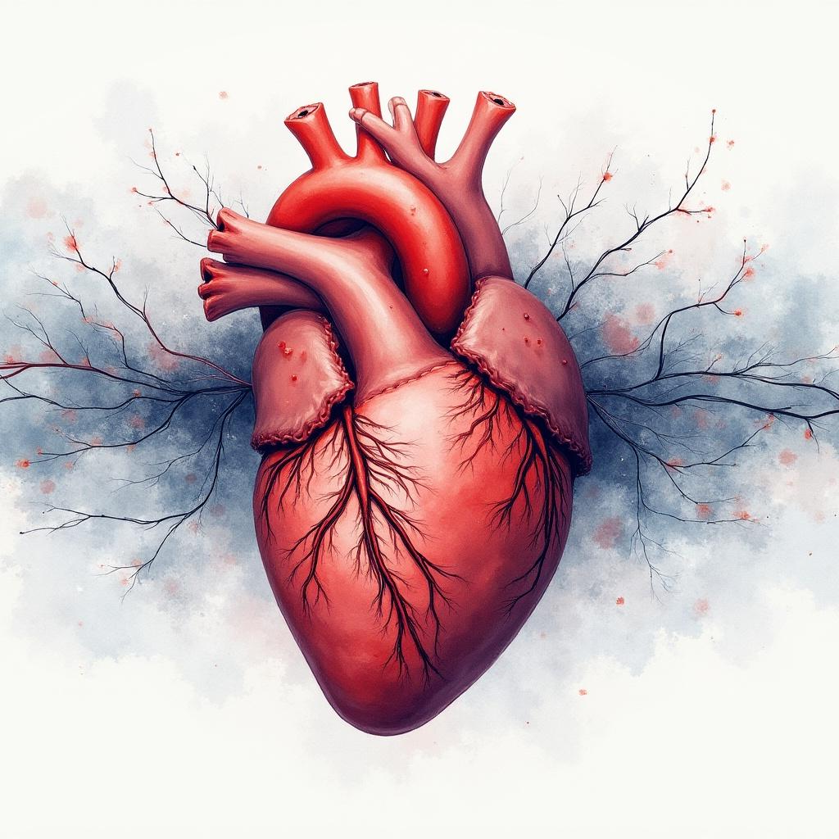
Introduction
Cardio Shield AI leverages advanced artificial intelligence to enable early detection and prevention of heart diseases. By analyzing routine patient data, it provides personalized risk assessments that support timely interventions. This presentation explores the systems purpose, benefits, and its potential to transform healthcare outcomes.

Slide 3

01
Heart Disease Overview

Slide 4
Causes of Heart Disease
Heart disease arises from multiple factors including genetic predisposition, unhealthy lifestyle habits such as poor diet and inactivity, and medical conditions like high blood pressure and diabetes. Additionally, obesity imposes extra strain on the heart, increasing the risk of cardiovascular complications.
Understanding these causes is crucial in developing effective prevention strategies.

Slide 5

Impact on Health
Heart diseases remain a leading cause of mortality worldwide, significantly reducing quality of life. Early diagnosis and management can prevent severe outcomes such as heart attacks and strokes. Addressing risk factors through lifestyle changes and medical care improves long-term health and reduces healthcare costs.

Slide 6
Lifestyle and Genetic Factors
Heart disease risk is influenced by both genetic predisposition and lifestyle choices. A family history significantly increases susceptibility, while factors such as smoking, poor diet, lack of exercise, and excessive alcohol intake exacerbate risks. Managing these lifestyle elements combined with awareness of genetic risks is essential for effective prevention and health maintenance.

Slide 7
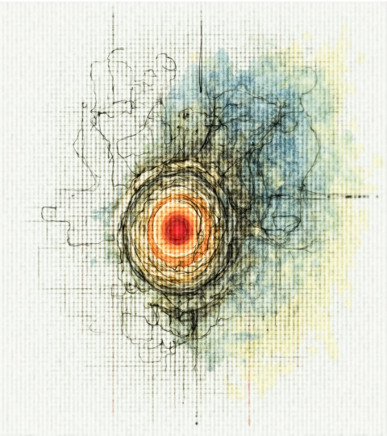
01
Cardio Shield AI System

Slide 8
Purpose and Goals
Cardio Shield AI was developed to address the growing burden of cardiovascular diseases. Its primary goal is to enable early detection of heart risks and facilitate preventive care. The system offers personalized risk assessments and improves diagnostic efficiency, empowering healthcare providers to intervene timely and potentially save lives.

Slide 9
Data Inputs and Features
Cardio Shield AI uses easily obtainable and low-cost patient data, including age, gender, blood pressure, cholesterol, glucose levels, and lifestyle factors like smoking and physical activity. It emphasizes routine health metrics without requiring expensive tests, making it accessible and practical for widespread use in clinical settings.

Slide 10

AI Workflow and Prediction Methods
The AI system processes input data through advanced algorithms, applying feature engineering such as pulse pressure calculation and BMI categorization. It combines multiple inputs into a composite risk index, providing accurate real-time predictions of heart disease risk. This streamlined workflow enhances clinical decision-making and supports early intervention strategies.

Slide 11

Conclusions
Cardio Shield AI represents a major advancement in heart disease prevention by integrating AI-driven insights with accessible health data. Its ability to provide early, personalized risk evaluation supports improved patient outcomes and reduces healthcare burdens. Continued adoption and development of this technology can significantly transform cardiovascular healthcare.

Slide 12
Thanks
Does anyone have any questions?
addyouremail@freepik.com
+91 620 421 838
yourwebsite.com
Please keep this slide for attribution

